Slide 1
Working with Data in R: An Overview
Michael Otterstatter, PhD
Workshop in Geospatial Methods
Supplementary material

Slide 2
Outline
R and RStudio
layout and functionality
Getting started
base R
installing and using R packages
the tidyverse
Importing data
Exploring, manipulating and summarising data
Selected resources

Slide 3

Caveats
The following slides introduce working with data in R for new users – the content is a selection of topics and is not meant to be comprehensive
The material is presented in an applied context, with examples, but generally does not explain underlying concepts or mechanics of R
The slides are meant as a stand-alone reference and can be used for self-study in conjunction with the accompanying R script ‘tidy data examples.R’

Slide 4
R and RStudio

Slide 5




Key ingredients
R is a freely available, open source, program for data manipulation, visualization and statistical analysis: https://cran.r-project.org/
Microsoft produces an enhanced version of R, called Microsoft R Open, with additional pieces for efficiency and reproducibility https://mran.microsoft.com/open
R Studio is a freely available, user friendly interface for using R: https://www.rstudio.com/
R packages are freely available open source ‘libraries’ of functions for particular tasks, analyses and computations: https://cran.r-project.org/web/packages/ and https://www.rstudio.com/products/rpackages/

Slide 6




Think of it this way…
Rstudio is the dashboard of controls
R is the engine ‘under the hood’
R packages are the supplies you’ll need on your trip

Slide 7

Characteristics of R
R is used by running commands written in R language (aka ‘R code’ or ‘R scripts’), not by point-and-click
R/R Studio is similar to other statistical software
implements all standard statistical analyses & plots
user interface with windows and tabs to assist navigation
fast computation times, but some memory restrictions
Yet there are also some differences
R functions exist in packages that must be installed (one-time only) and called (each time R is used)
R program is continually evolving (4-5 updates / year to R)
R does not come with a comprehensive User’s Manual

Slide 8
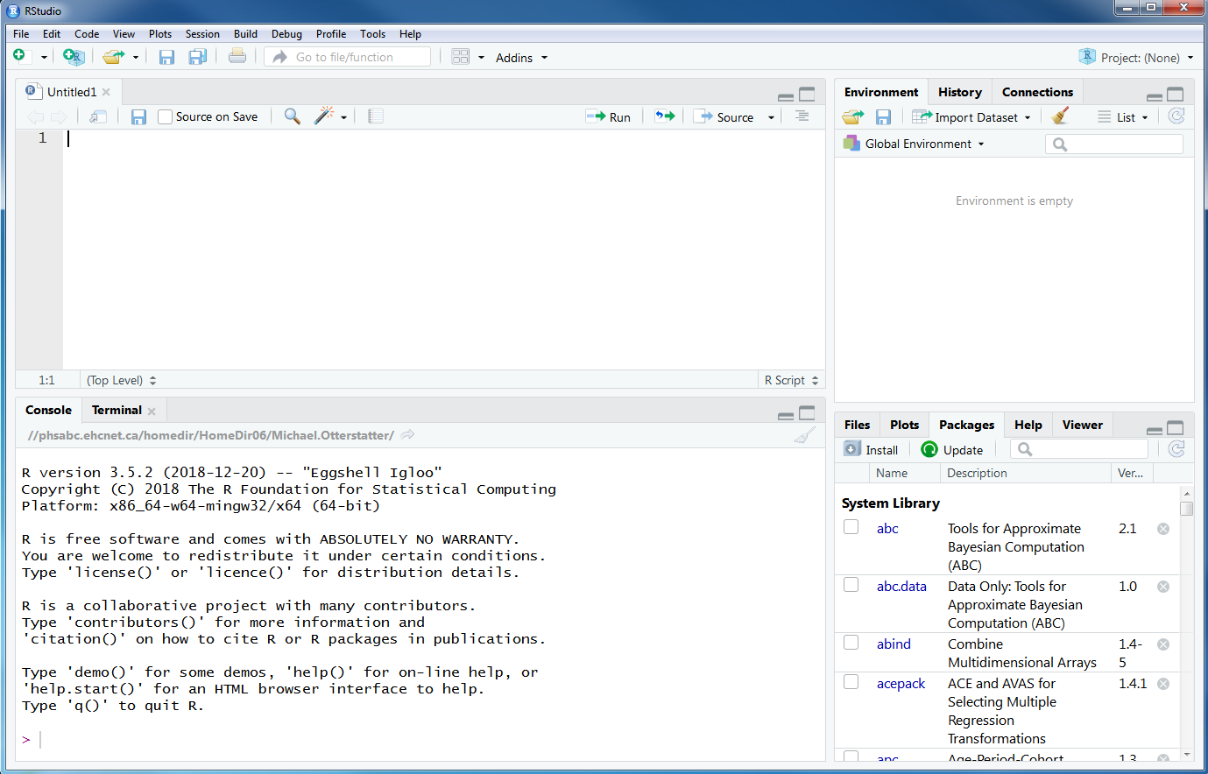
R/RStudio layout

Slide 9
R/RStudio layout
Data sets, defined variables, functions and other objects listed in environment window
Code is written in the script editor window
Code is run and output appears in the console window
File lists, generated plots, installed packages, help files, html content shown in explorer window

Slide 10
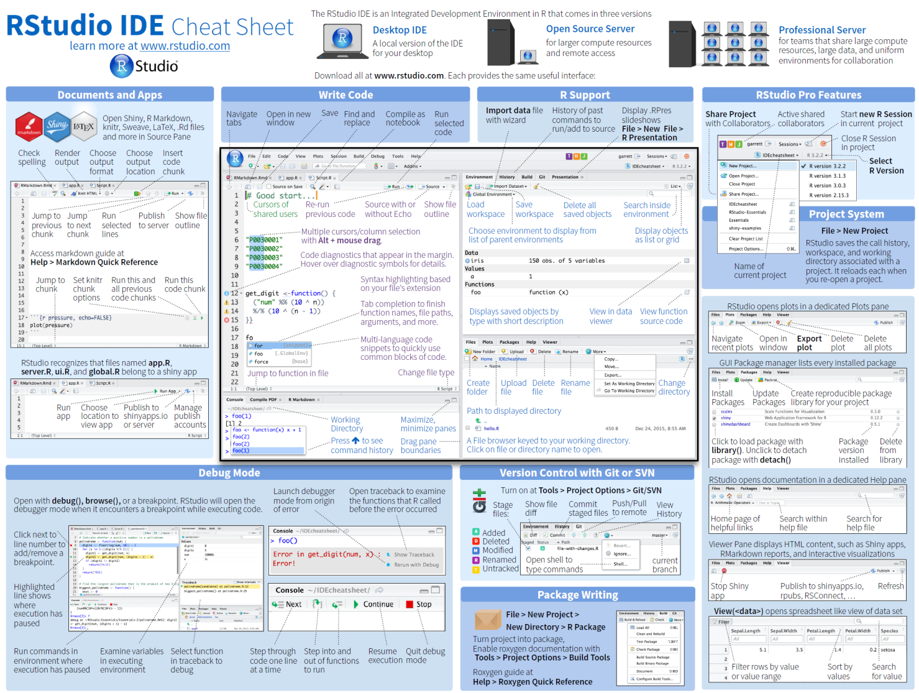
R/RStudio layout
For a quick summary of RStudio functions: https://github.com/rstudio/cheatsheets/raw/master/rstudio-ide.pdf

Slide 11
Getting started

Slide 12
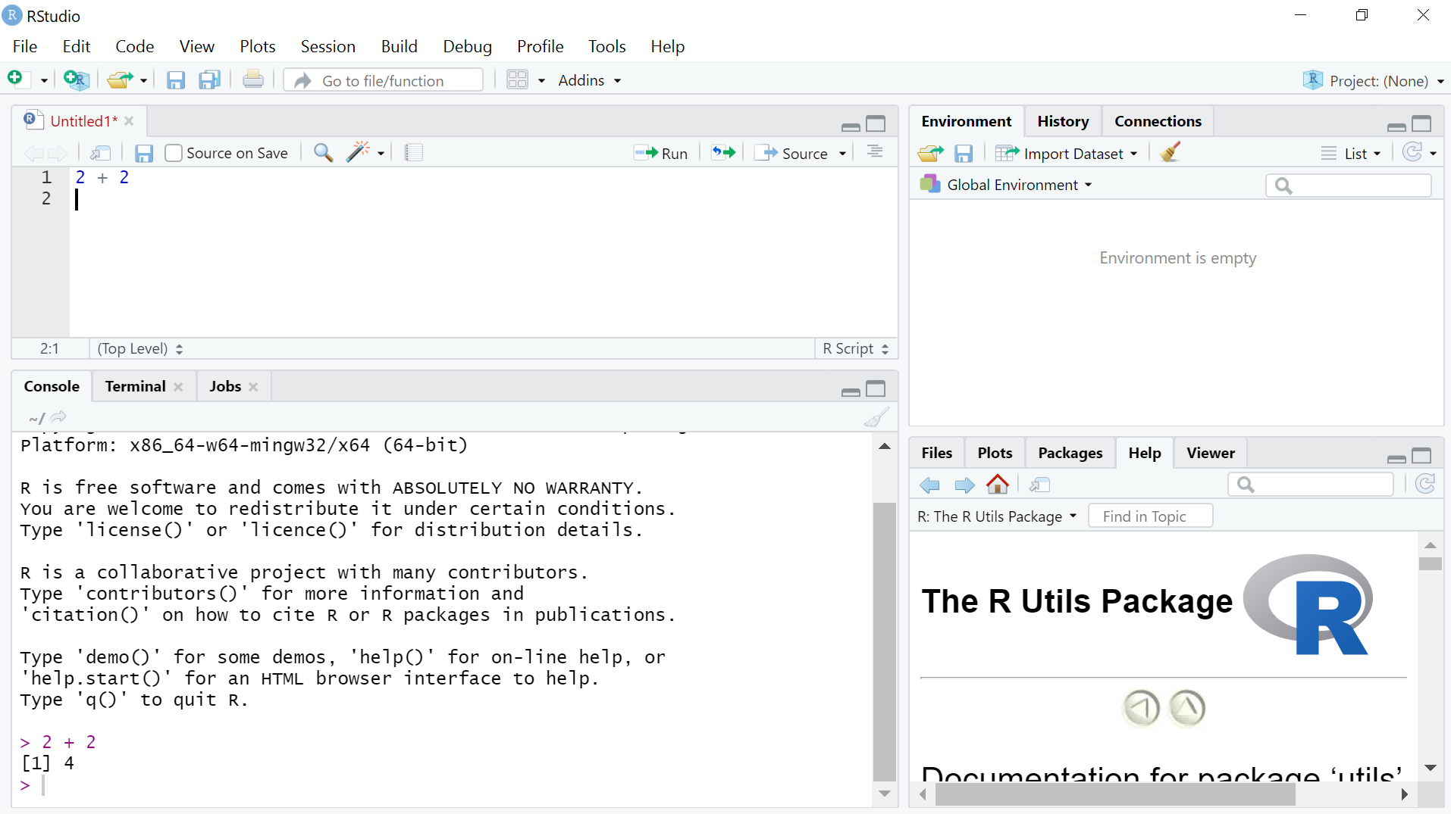
Working in R: base R
type commands in editor window and run using Ctrl + Enter
Commands and results appear in Console window (you can also enter commands directly here)

Slide 13
Working in R: base R
The most basic functionality uses R as a fancy calculator
> 5 + 4
[1] 9
> 1 - exp(0.32 * 5)
[1] -3.953032
> (4/3) * pi * (5^3)
[1] 523.5988

Slide 14
Working in R: base R
Many things you work with in R can usefully be thought of as objects
variables, data sets, vectors, lists, tables, matrices, etc.
Create objects by assigning ( <- ) names and values
> a <- 7
> b <- 3
> my_sum <- a + b
Work with objects by referencing their name
> my_average <- my_sum / 2

Slide 15
Working in R: base R
Typically R does not generate output unless asked, but we can see the contents of an object by typing its name
> city_names <- c('Vancouver','Calgary','Regina','Winnipeg’)
> city_names
[1] "Vancouver" "Calgary" "Regina" "Winnipeg"
Note that it is often convenient to group (or concatenate) lists of values using the c() function

Slide 16
Working in R: base R
R naturally performs operations on lists (vectorized operations) making tasks more efficient
> dataset_1 <- c(3,8,2,NA,7,1,5)
> dataset_2 <- c(6,2,5,4,6,1,3)
> dataset_1 + dataset_2
[1] 9 10 7 NA 13 2 8
More efficient than specifying
(3+6), (8+2), (2+5)…, etc.

Slide 17
Working in R: base R
R naturally performs operations on lists (vectorized operations) making tasks more efficient
> dataset_1 <- c(3,8,2,NA,7,1,5)
> dataset_2 <- c(6,2,5,4,6,1,3)
> dataset_1 + dataset_2
[1] 9 10 7 NA 13 2 8
> sum(dataset_1, dataset_2)
[1] NA
> sum(dataset_1, dataset_2, na.rm = TRUE)
[1] 53
Many premade functions exist to perform common tasks; these are used by specifying:
function_name(arguments)

Slide 18
Working in R: base R
R naturally performs operations on lists (vectorized operations) making tasks more efficient
> dataset_1 <- c(3,8,2,NA,7,1,5)
> dataset_2 <- c(6,2,5,4,6,1,3)
> dataset_1 + dataset_2
[1] 9 10 7 NA 13 2 8
> sum(dataset_1, dataset_2)
[1] NA
> sum(dataset_1, dataset_2, na.rm = TRUE)
[1] 53
NA is R notation for a
missing value
Operations in R often require the user to explicitly indicate how missing values will be handled

Slide 19
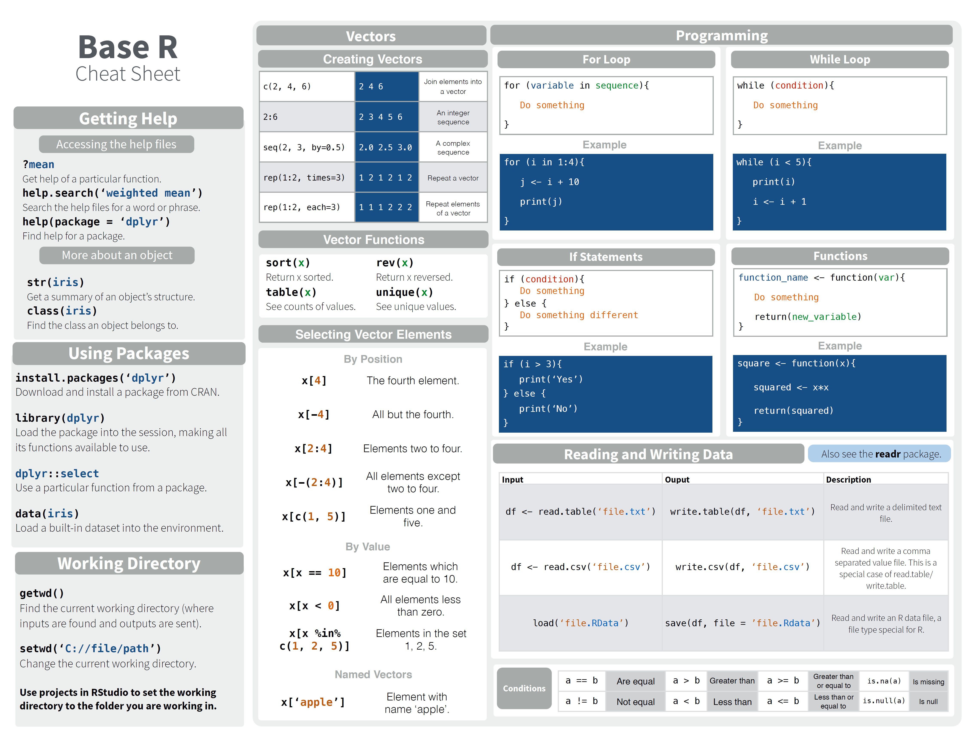
Working in R: base R
http://github.com/rstudio/cheatsheets/raw/master/base-r.pdf

Slide 20
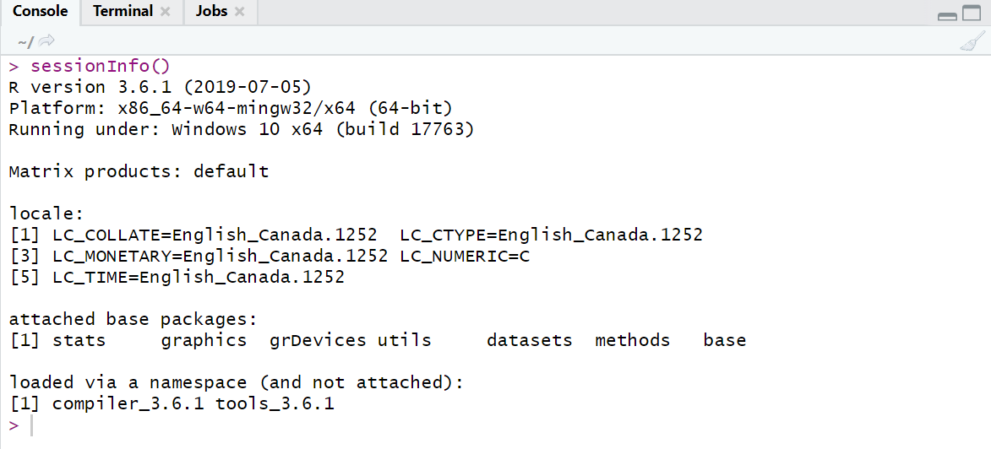
Working in R: installing packages
Note that when you open R, several packages are automatically loaded, with basic functions for
data import/export, manipulation, statistics, graphics, etc.
we call this core functionality ‘base R’

Slide 21
Working in R: installing packages
But the functionality of base R is not always adequate (or efficient) for modern data work
Often, we will load several additional packages containing advanced data and analytic functions
The first time we use a package, it must be downloaded and installed; after that, we only need to load the package when we need it

Slide 22
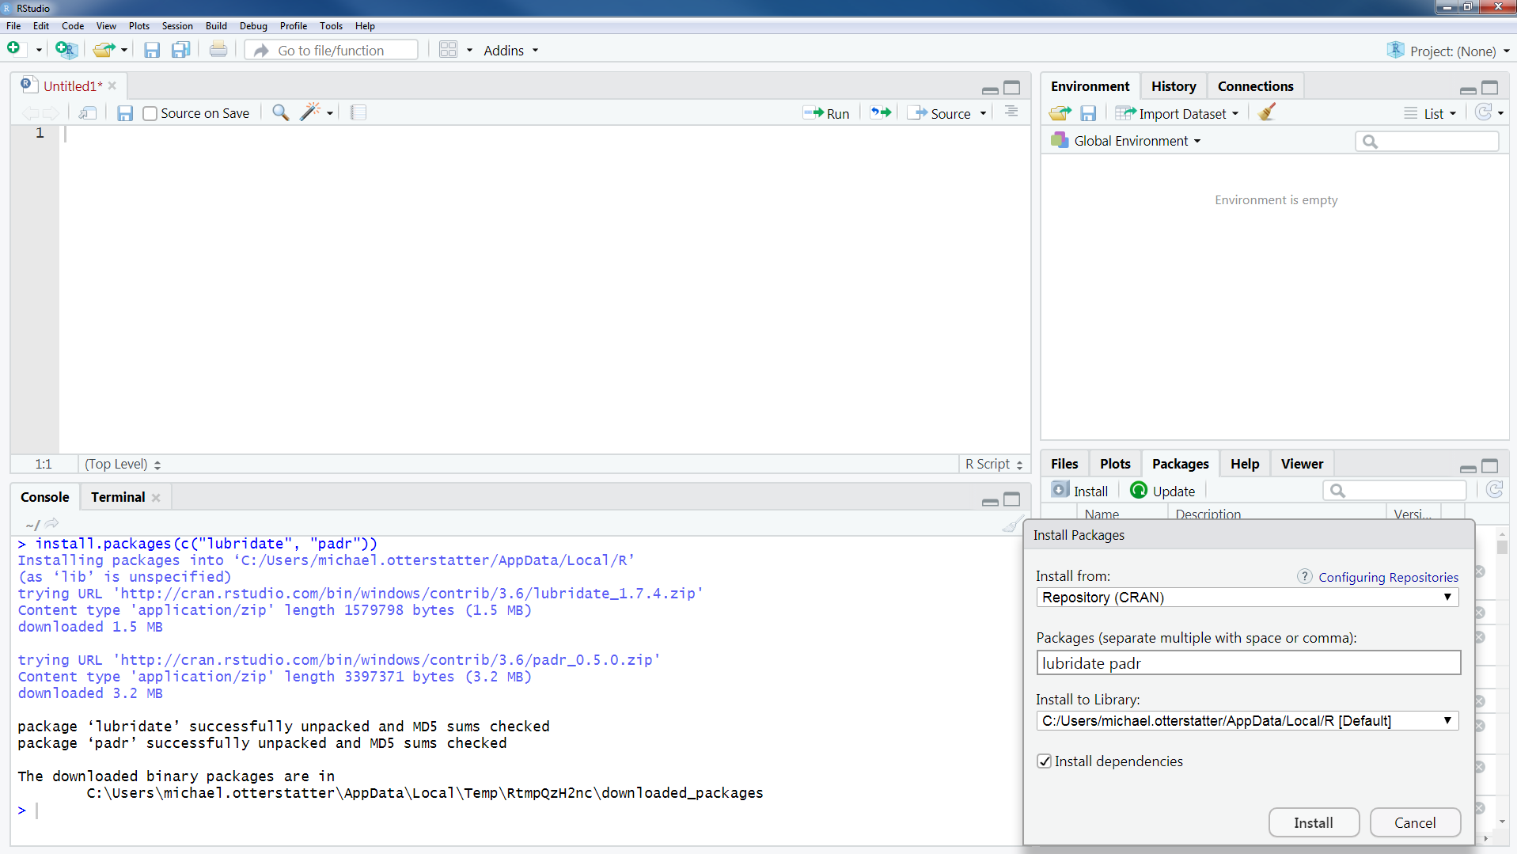
Working in R: installing packages
Or, click Install button and specify packages in dialogue box
use install.packages() function in Console window to specify which package to install

Slide 23
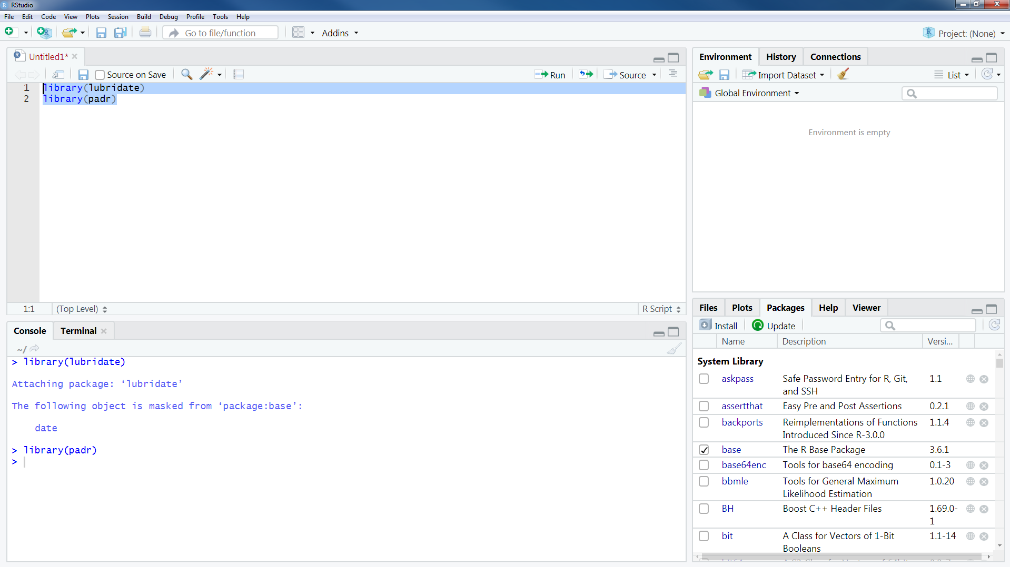
Working in R: installing packages
Installed packages can then be loaded as needed using the library() function

Slide 24

Working in R: the tidyverse
tidyverse: a series of R packages by Hadley Wickham and colleagues, built specifically for efficient data wrangling and analysis
http://hadley.nz/ and http://tidyverse.org/

Slide 25
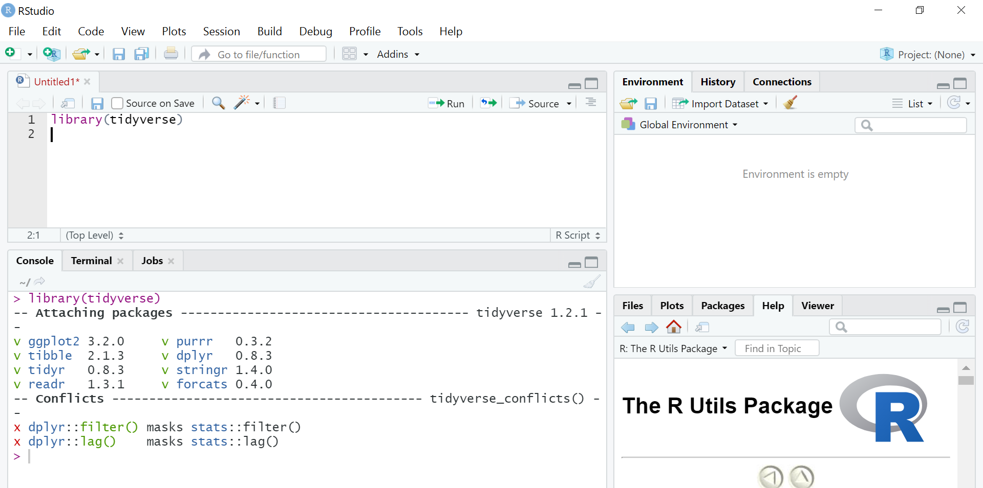
Working in R: the tidyverse
start any and all data work by loading the tidyverse master package
Contains a variety of functions for data import, manipulation, plotting, etc

Slide 26

Working in R: the tidyverse
A great (and free) introduction to tidy data work can be found in the online text R for Data Science https://r4ds.had.co.nz/

Slide 27
Tidy data tools in R
https://s3.amazonaws.com/assets.datacamp.com/blog_assets/Tidyverse+Cheat+Sheet.pdf

Slide 28
Importing data

Slide 29
Importing data
Regardless of the analytic task, we almost always begin by importing data (e.g., spreadsheet, webpage, database) for further manipulation and analysis

Slide 30
Importing data with tidyverse package readr
readr can import from 7 different file formats:
read_csv(): comma separated (csv) files
read_tsv(): tab separated files
read_delim(): general delimited files
read_fwf(): fixed width files
read_table(): tabular files with columns separated by white-space.
read_log(): web log files
All have similar form and syntax, so we will focus on read_csv as the most commonly used example

Slide 31
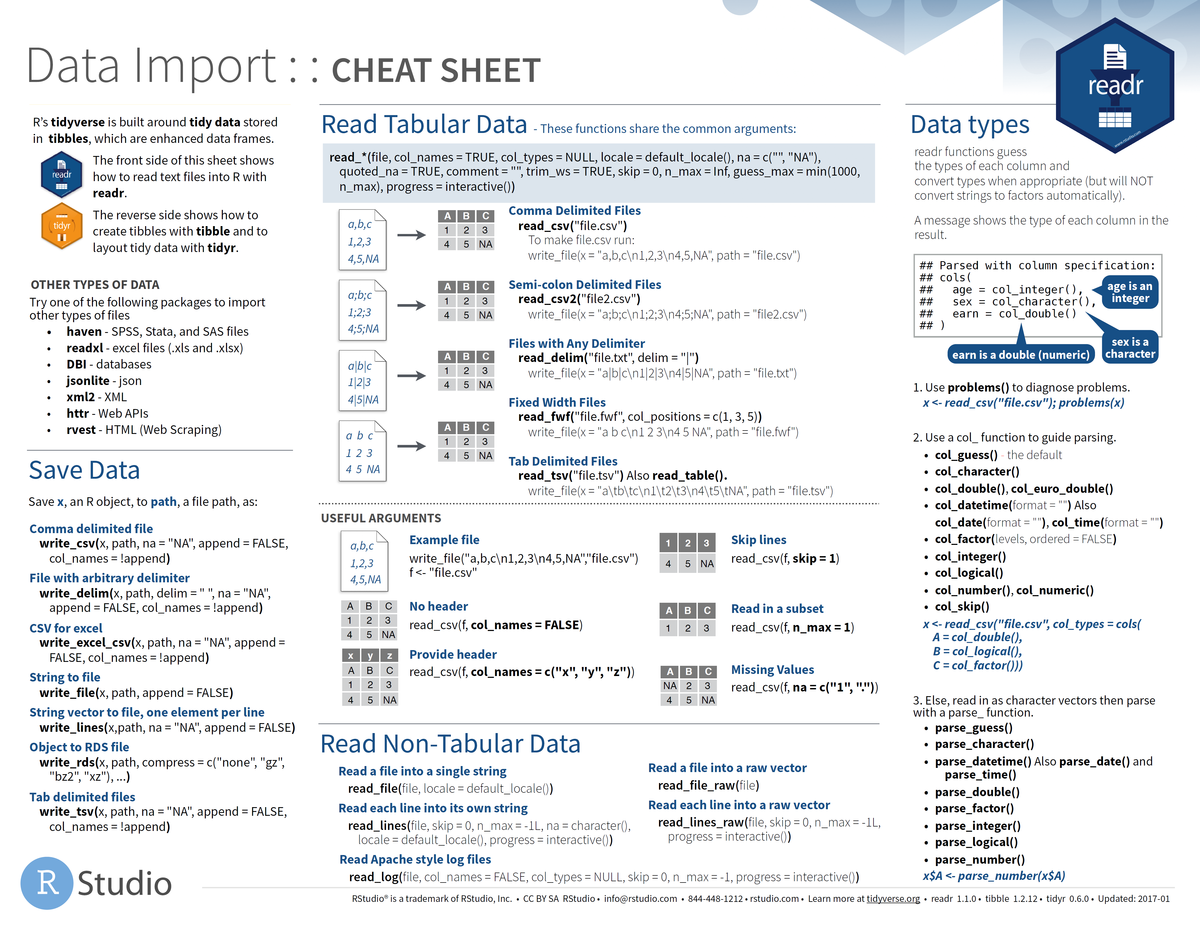
https://www.rstudio.com/resources/cheatsheets/

Slide 32
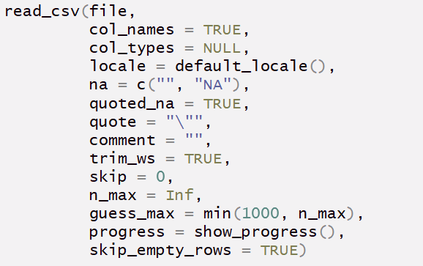
Introducing read_csv
Many options can be specified in read_csv (although usually don’t need to be)

Slide 33
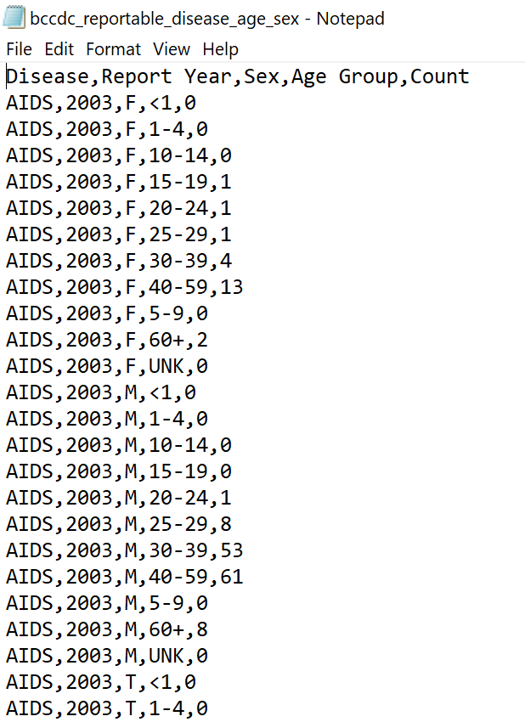
Let’s use a csv file of reportable disease by year, age and sex as an example
http://www.bccdc.ca//health-professionals/data-reports/reportable-diseases-data-dashboard

Slide 34
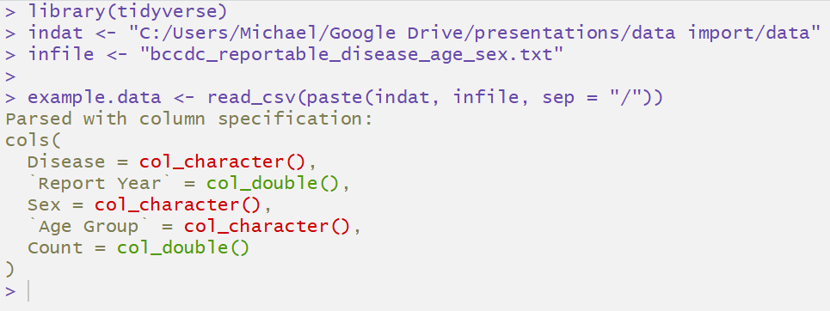
Importing data with read_csv
Most of the time, you only need to specify the file location and read_csv will helpfully do the rest

Slide 35
Importing data with read_csv
Most of the time, you only need to specify the file location and read_csv will helpfully do the rest
Note that readr has guessed the appropriate column formats, but tells you explicitly in case any are incorrect

Slide 36
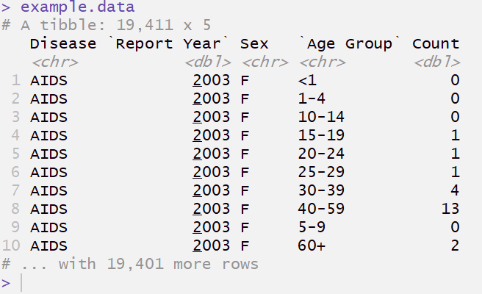
Importing data with read_csv
What did read_csv do?

Slide 37
Importing data with read_csv
Imports data as a ‘tibble’ (a rectangular dataset)
What did read_csv do?
Preserves column names

Slide 38
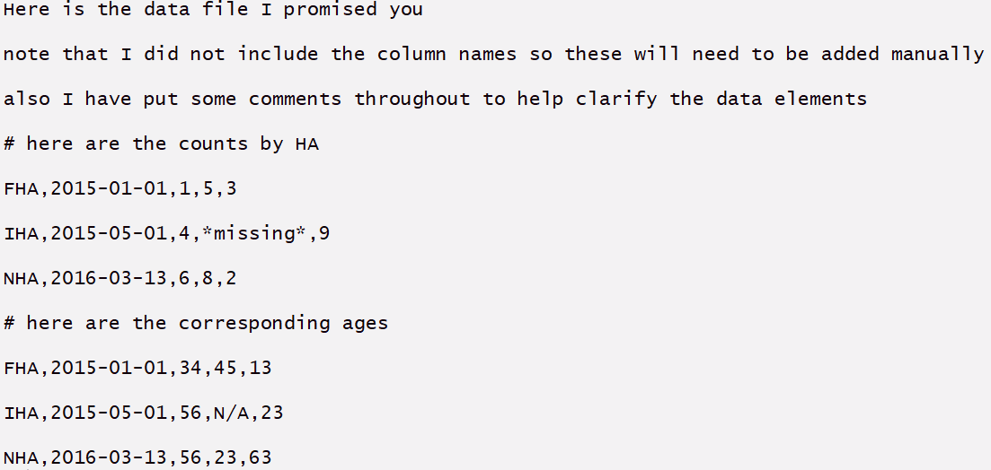
A messier example
What if we receive the data as a text file or spreadsheet with unneeded text and comments interspersed with the data?

Slide 39
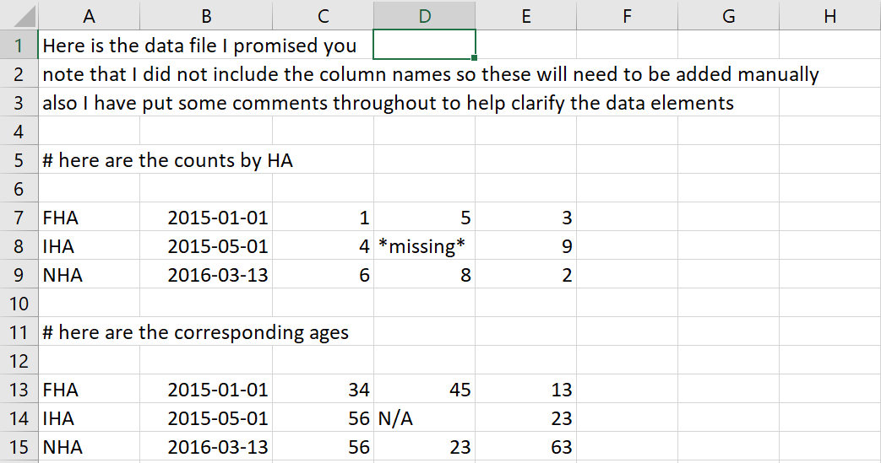
A messier example
What if we receive the data as a text file or spreadsheet with unneeded text and comments interspersed with the data?

Slide 40
A messier example
We can make use of optional settings in read_csv

Slide 41
A messier example
We can make use of optional settings in read_csv
add column names
specify codes indicating missing data
specify codes indicating comments
number of rows to skip at beginning
drop rows with no data

Slide 42
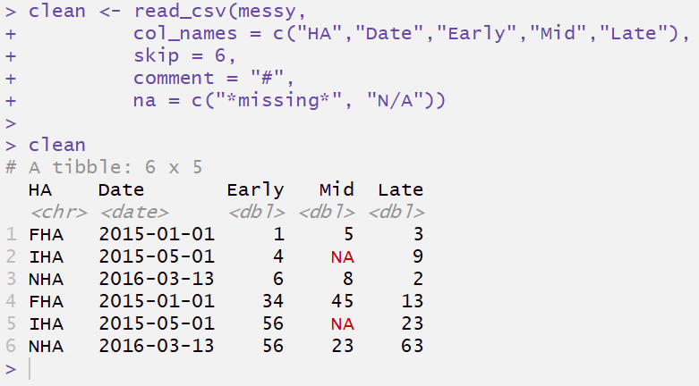
A messier example

Slide 43
A messier example
Specify column names
Skip beginning rows and comments
Specify codes used for missing data
Also, by default read_csv automatically skipped empty rows

Slide 44
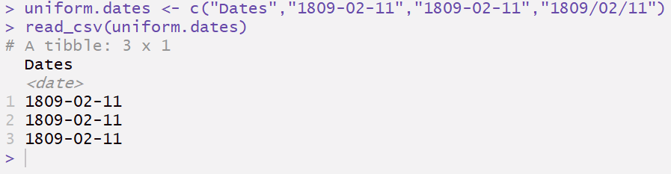
Dealing with dates
read_csv recognizes dates that are consistently presented in the form YYYY-MM-DD

Slide 45
Dealing with dates
read_csv recognizes dates that are consistently presented in the form YYYY-MM-DD
Properly formatted as a date

Slide 46
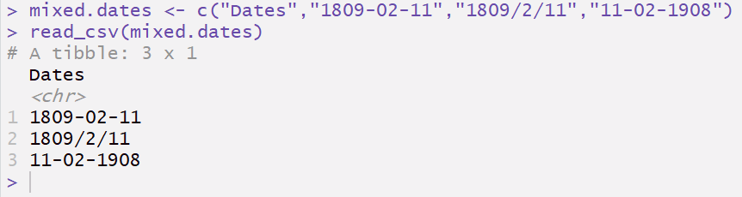
Dealing with dates
When dates are not uniformly presented, read_csv simply formats as character (preserves the original data) and let’s you do the clean-up
when in doubt, formatted as a character

Slide 47
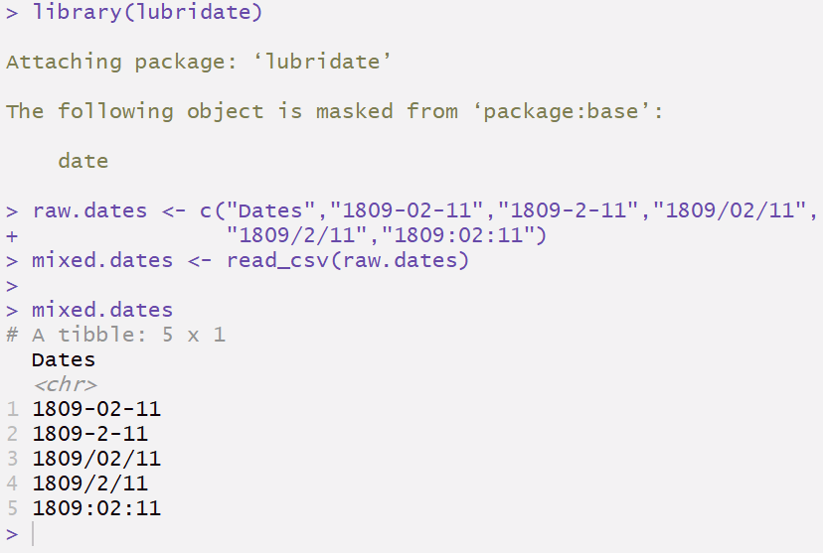
Dealing with dates
Fortunately, with tidy data tools like the lubridate package, working with dates is easy

Slide 48
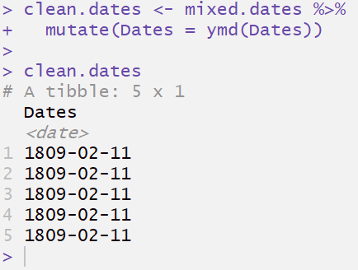
Dealing with dates
We only need specify the ordering of the date components (e.g., ymd indicates year, month, day order), lubridate does the rest
Now properly formatted as a date

Slide 49
Exploring, manipulating and summarising data

Slide 50
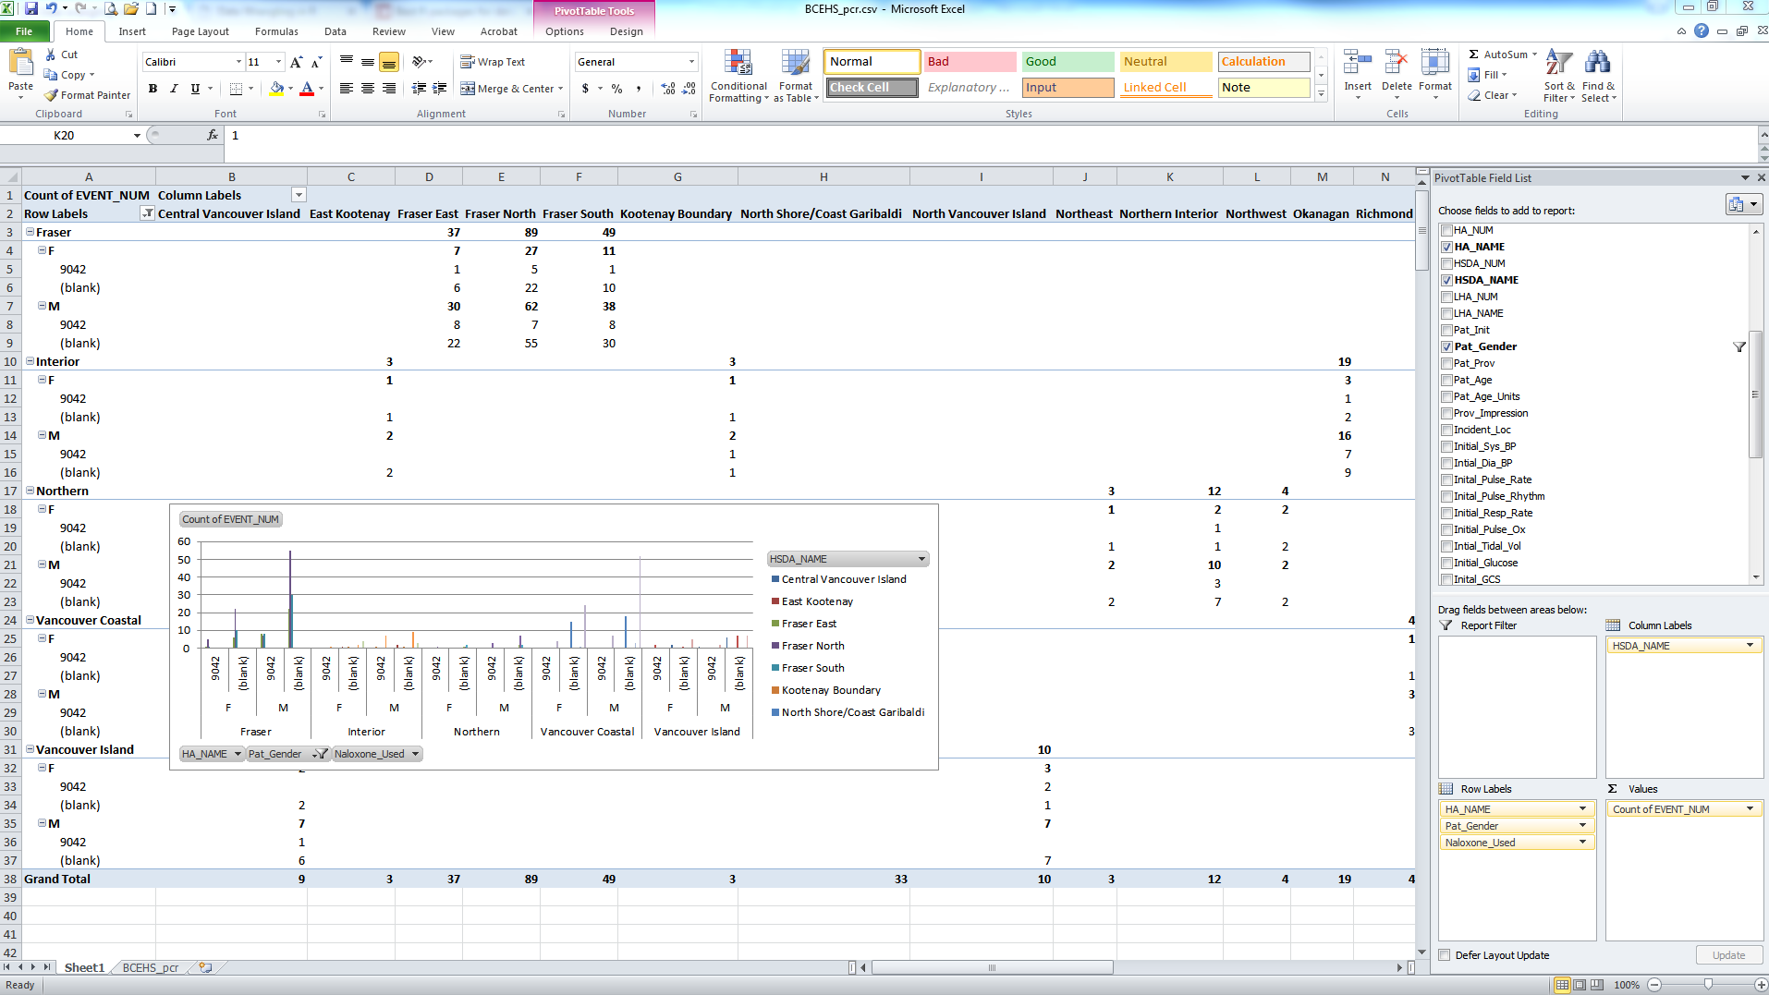

Messy data
Datasets are now typically too large and complex to be efficiently handled in spreadsheets

Slide 51
‘Wrangling’ messy data
Data wrangling: process of converting raw data into a format allowing convenient ‘consumption’, including visualization, aggregation, statistical modeling, etc.
The process typically follows general steps beginning with importing raw data and then "munging" these into tidy data
https://en.wikipedia.org/wiki/Data_wrangling

Slide 52

Tidy data
Basic structure of tidy data
each variable is saved in its own column
each observation (individual, or other unit) is saved in its own row
data cells contain values of variables

Slide 53
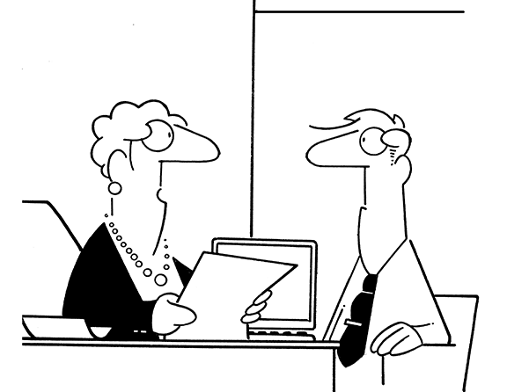
Not tidy ☹
“I need these summarised by age group.”

Slide 54
Not tidy ☹
“I changed my mind. I need these summarised by Health Authority.”

Slide 55
Tidy ☺

Slide 56
Tidy ☺
Variables as columns

Slide 57
Tidy ☺
Observation units as rows

Slide 58
Tidy ☺
Data cells are values of variables

Slide 59
Why Tidy?
General benefit: a consistent way of structuring/storing data, making it easier to learn tidy data tools. These tools work consistently with tidy data because of their standardized structure
Specific benefit: variables as columns allows efficient use of R, which typically functions by using vectors of values

Slide 60
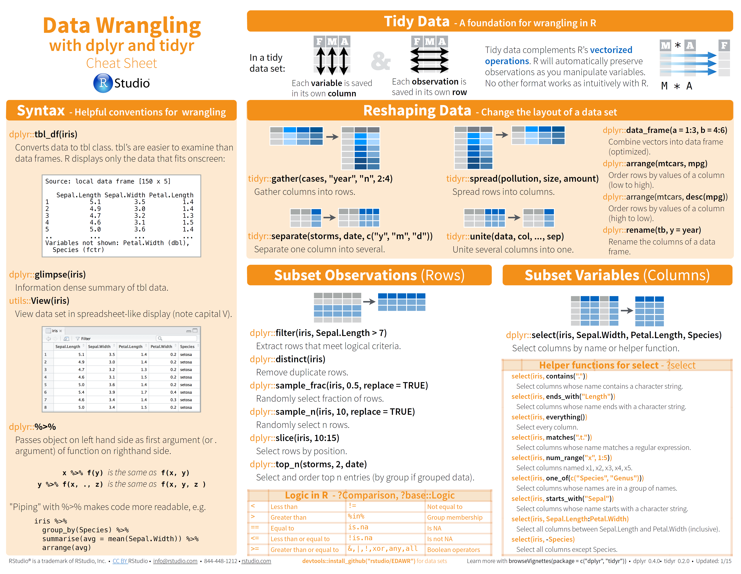
Tidyverse packages dplyr and tidyr
http://www.rstudio.com/wp-content/uploads/2015/02/data-wrangling-cheatsheet.pdf

Slide 61
Tidy data tools in R
Typically the tidyverse commands will have the form: command(data, optional variables)
filter(my_data, date == ‘2019-10-31’)
We can get more information on any loaded function by typing ?function_name in the Console window
?filter

Slide 62
Note: The following slides can be studied in conjunction with the accompanying R script: ‘tidy data examples.R’

Slide 63
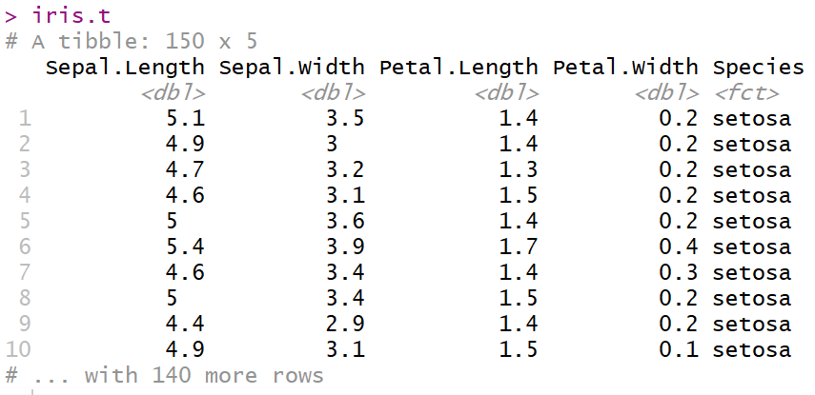
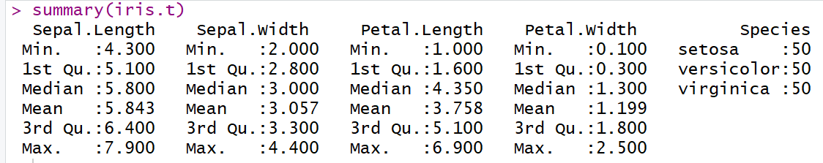
Example dataset iris.t

Slide 64

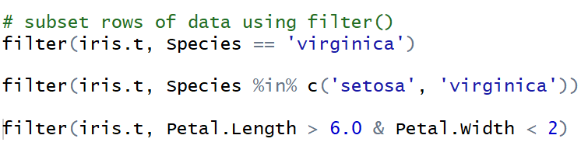
Tidy data using dplyr
filter()

Slide 65
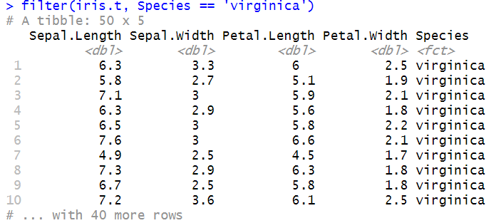
Tidy data using dplyr
filter()

Slide 66
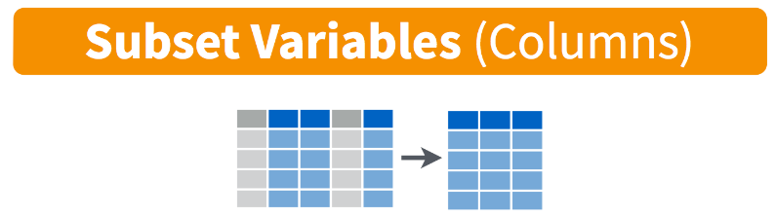
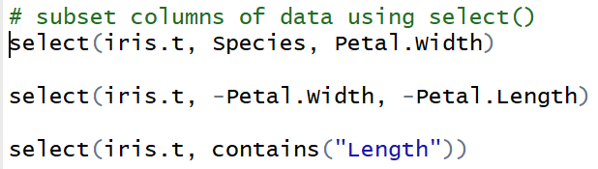
Tidy data using dplyr
select()

Slide 67
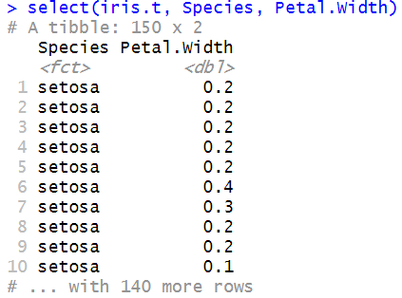
Tidy data using dplyr
select()

Slide 68
Tidy data using dplyr

Slide 69
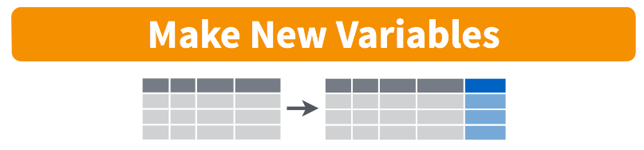
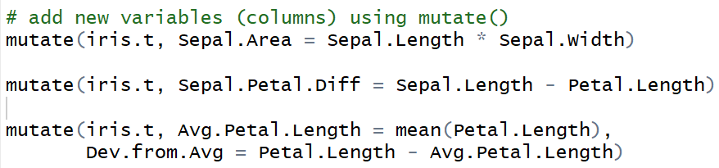
Tidy data using dplyr
mutate()

Slide 70
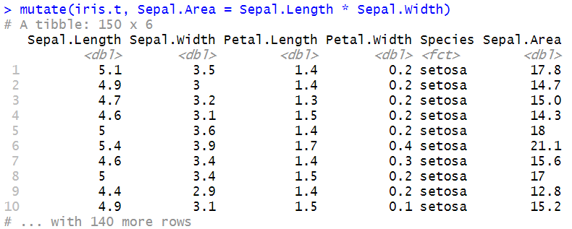
Tidy data using dplyr
mutate()

Slide 71

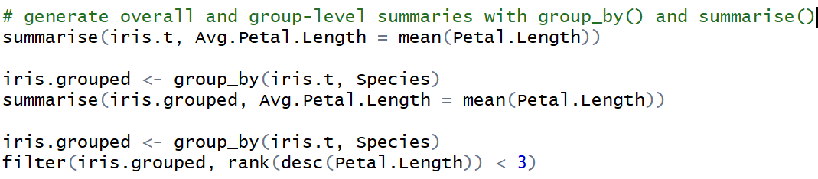
Tidy data using dplyr
group_by() and summarise()

Slide 72
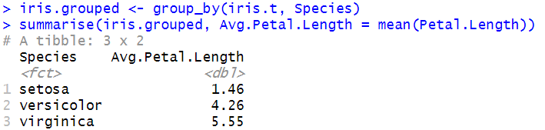
Tidy data using dplyr
group_by() and summarise()
Note that group_by() creates an invisible stratification within a dataset, and all operations performed afterwards are done by group

Slide 73
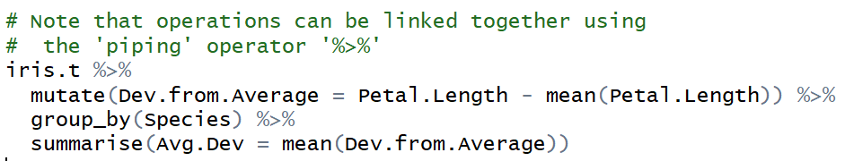
Piping
In multi-step data manipulation, tidy data tools provide an efficient way to link individual operations together into a single block of code using the piping operator
Note that the original dataset only needs to be specified once, at the beginning

Slide 74
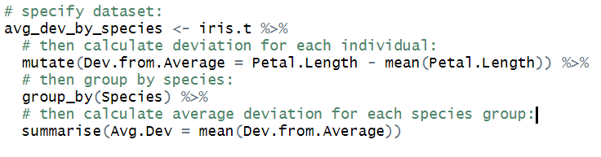
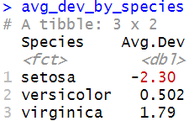
Piping

Slide 75
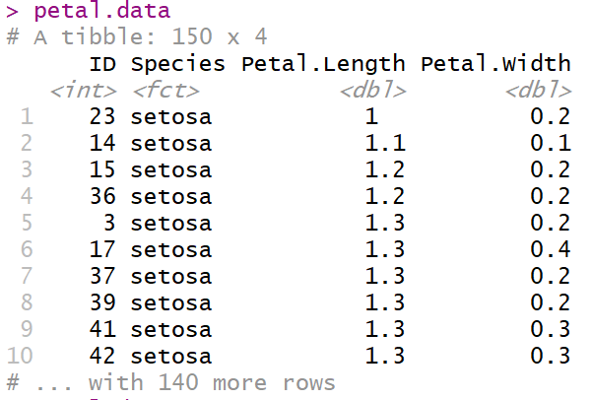
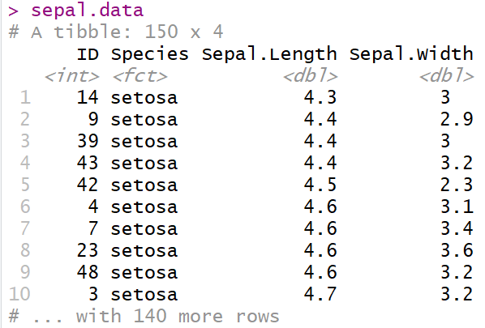
Tidy data using dplyr
left_join(), inner_join()and full_join()

Slide 76
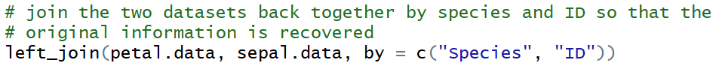
Tidy data using dplyr
left_join(), inner_join()and full_join()

Slide 77
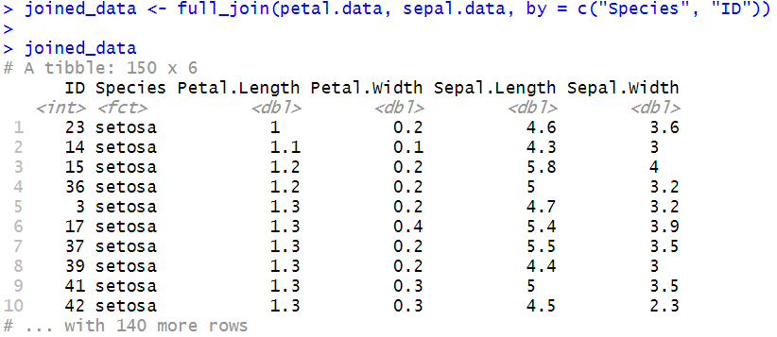
Tidy data using dplyr
left_join(), inner_join()and full_join()

Slide 78
Tidy data using dplyr
For more details see: http://stat545.com/bit001_dplyr-cheatsheet.html

Slide 79
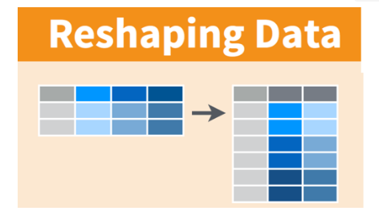
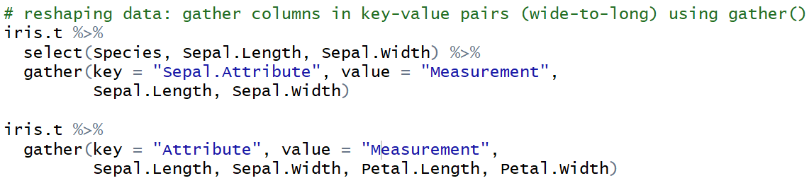
Tidy data using tidyr
Wide-to-long format: gather(key=, value=)

Slide 80
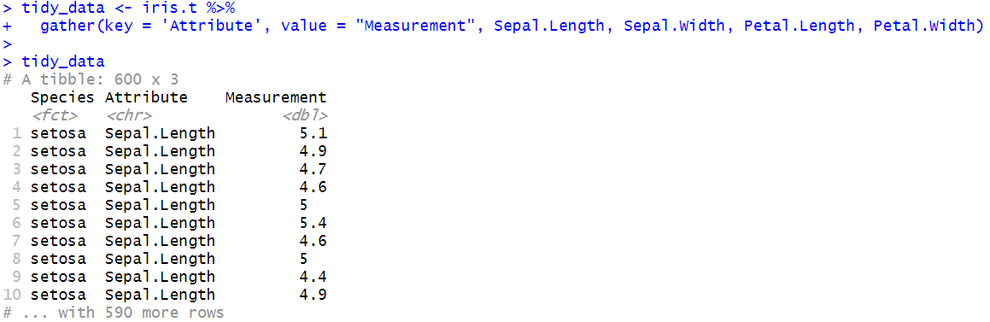
Tidy data using tidyr
Wide-to-long format: gather(key=, value=)

Slide 81
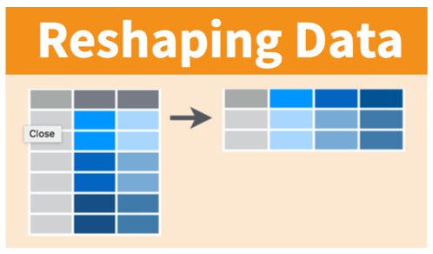
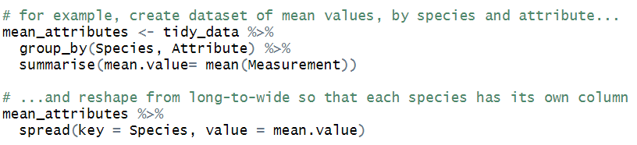
Tidy data using tidyr
Long-to-wide format: spread(key=, value=)

Slide 82
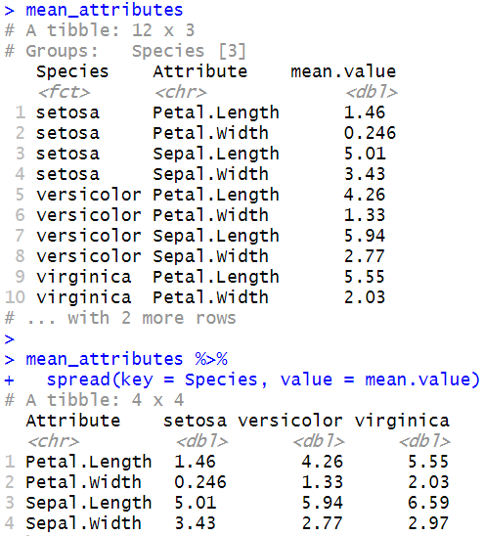
Tidy data using tidyr
Long-to-wide format: spread(key=, value=)

Slide 83
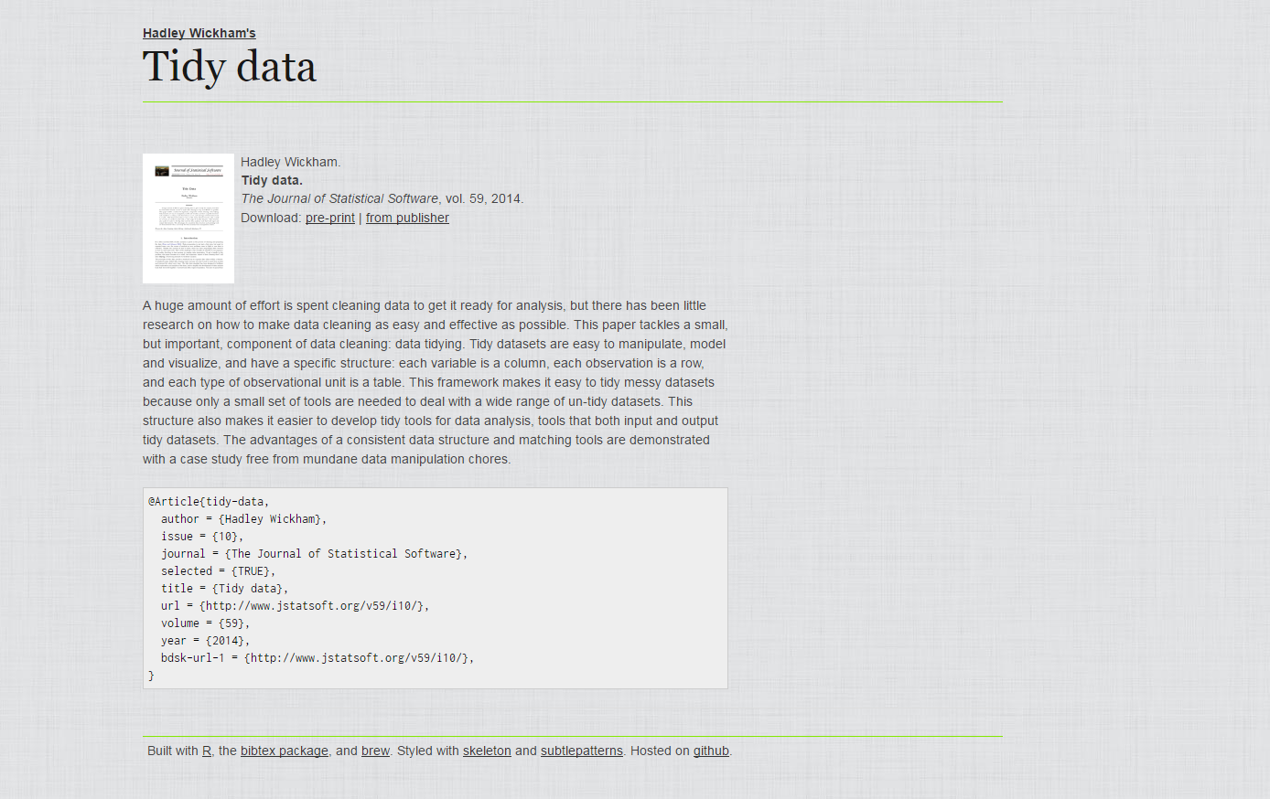
Getting started – tidy data paper
http://vita.had.co.nz/papers/tidy-data.html

Slide 84
Resources

Slide 85
Selected resources
R for Data Science book: https://r4ds.had.co.nz/
Video tutorials:
https://www.r-bloggers.com/hadley-wickhams-dplyr-tutorial-at-user-2014-part-1/
https://www.r-bloggers.com/hadley-wickhams-dplyr-tutorial-at-user-2014-part-2/
Quick references & cheatsheets:
https://www.rstudio.com/resources/cheatsheets/
https://github.com/rstudio/cheatsheets/blob/master/data-transformation.pdf
https://github.com/rstudio/cheatsheets/blob/master/data-import.pdf
Tidy data examples:
http://jules32.github.io/2016-07-12-Oxford/dplyr_tidyr/#
https://rstudio-pubs-static.s3.amazonaws.com/109948_876c577ae6424d47b529fce960db7bf4.html#1

Slide 86

Thank you / questions
michael.otterstatter@gmail.com

